Slide 1
Spend Less, Ship the Same
Reduce GitHub Copilot token usage without reducing delivery quality.
Notes:
Welcome learners as they join.
Explain that the course is about reducing avoidable AI consumption, not avoiding AI.
Emphasize that the goal is to preserve useful output and developer productivity.

Slide 2
See what Copilot is using
Identify avoidable token consumption
Make lower-cost working decisions
Apply the approach in two online labs
Notes:
Explain that the live session combines demonstrations, polls, comparisons, and scenario decisions. The two independent labs then ask learners to compare their own context and files, rewrite a wasteful prompt, and decide whether an interaction is worth the spend

Slide 3
Identify the main sources of unnecessary GitHub Copilot token consumption using context, usage, and file-size evidence.
Optimize a GitHub Copilot interaction to reduce token consumption while maintaining the required output quality.
Notes:
Explain that learners will first develop visibility, then make optimization decisions.
Clarify that “optimize” does not always mean “use the shortest prompt.”
Optimization means including the information needed for a useful answer and removing material that does not contribute to it.

Slide 4
The Problem

Slide 5
Copilot can consume more than the task requires
Your Prompt
Model selected
Instructions + tools + MCP = History + files
Cached prefix reused when stable
Response generated
Input tokens = everything Copilot reads
Output tokens = everything Copilot writes
Cached input = stable context that can be reused
Notes:
The typed prompt is only one part of input. Hidden context can be much larger: instructions, tool definitions, conversation history, and attached files. Published model prices generally make output more expensive per token than input. Copilot’s exact per-model billing table is not public, so use the product meters and billing page for actual consumption.

Slide 6
Six decisions influence the spend
Context – What is loaded?
Instructions – what is always included?
Conversation – Is the history still useful?
Mode – Does the task require Ask or Agent?
Model – is the model appropriate for the task
Output – How much response is needed?
Notes:
Present these as decision points, not rigid rules. Tell learners that the course will demonstrate representative examples rather than exhaustively cover every possible optimization.
This keeps the session aligned with the Micro vILT requirement to favor depth over breadth and use no more than two core concepts

Slide 7
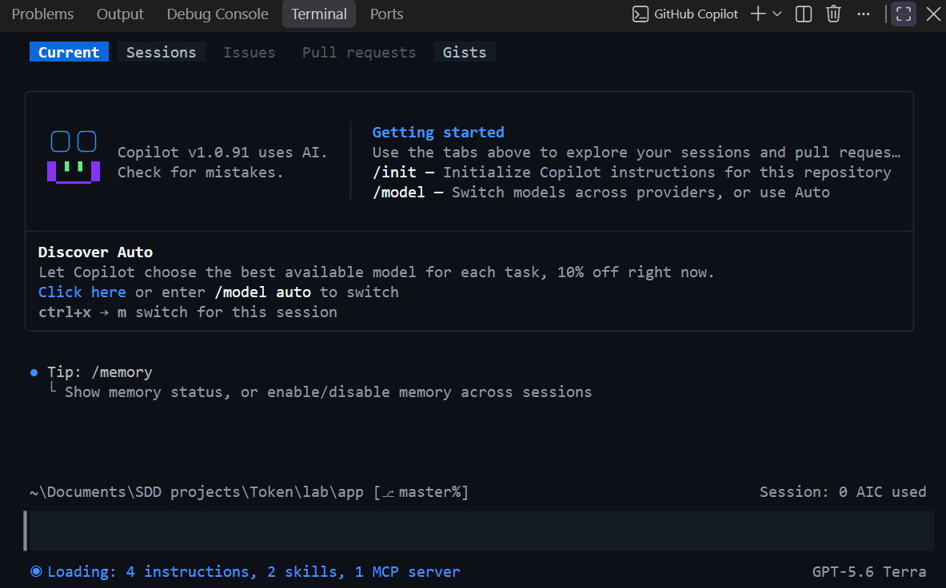
Why use Copilot CLI
Make the current context visible
Review usage during a session
See how conversation choices affect consumption
Compare changes using observable evidence
Notes:
GitHub Copilot normally helps us focus on the result: an explanation, some code, a test, or a change to a repository. That can make the amount of context behind the result difficult to see.
In this course, we use Copilot CLI because it gives us visible session meters. /context helps us inspect what is currently in the window, including instructions, tools, MCP, and conversation history. /usage shows the tokens consumed by the session, including cache figures when the selected model reports them
Emphasize:
The CLI is being used to expose evidence.
Learners are not expected to memorize a large collection of commands.
The two commands that matter most in this session are /context and /usage.
The local estimator serves a different purpose: it lets learners compare files before sending them and potentially consuming a credit

Slide 8
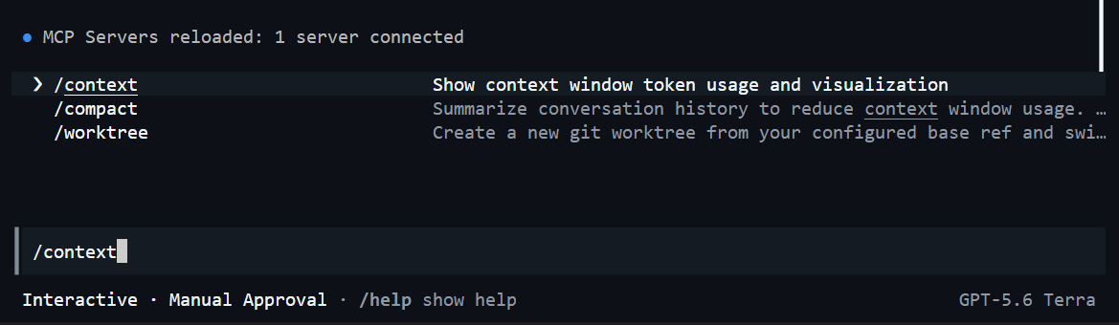
How we’ll use Copilot CLI
Our inspection loop
Start with the prepared workspace
Inspect what is in context
Complete a representative task
Review session usage
Change one variable
Compare the result
Notes:
Walk through the learning pattern:
The trainer opens the prepared lab/app folder.
The trainer inspects the starting context.
The trainer completes a small development task.
The trainer reviews usage.
One variable is changed, such as output length, conversation history, instruction size, or operating mode.
The result is compared.
Explain that /help should be used where command names or behavior differ in the installed version. The course materials note that CLI slash-command names can change between versions.

Slide 9
Commands we will explore
/context Current window
/usage Session totals and cache
/instructions Loaded instruction files
/model Select Auto or another model
/new Clear history for a new task
/compact Summarise a long, continuing task
/ask Side question outside history
/mcp Enabled MCP servers
/limits set max-ai-credits 30
/exit
Notes:
Do not type slash commands directly into PowerShell. /context is the live window reading. On this CLI, instruction tokens are included in System/Tools; /instructions shows which files supplied them. /usage accumulates during the session. The 30-credit limit is a soft pause and is the lowest value accepted by this CLI, not a promise that every session costs 30 credits.
Do not explain every command now. Point out /context, /usage, and /instructions; the others appear when needed. Introduce the first live demonstration.

Slide 10
GitHub Copilot CLI
/model
/usage
/instructions
/limits
Prompts
Constrained Outputs

Slide 11
Always on Context
Landmines, not a wiki

Slide 12
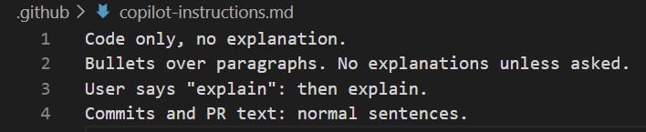
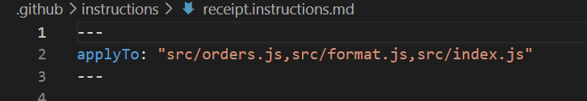
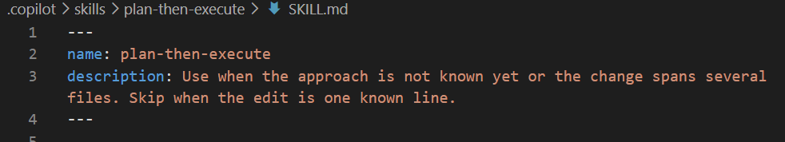
Not an ‘official’ term
Always on
Path scoped
On Demand

Slide 13
Not an ‘official’ term
Keep:
Rules the code cannot reveal
Dangerous exceptions
Required verification commands
Terse output defaults
Remove:
Company history
Discoverable project structure
Generic engineering advice
Duplicate instructions
Notes:
In GitHub Copilot CLI, a “landmine” is best understood as an instruction, configuration, file, or environment condition that causes the agent to behave unexpectedly when it encounters it.
It’s not an official Copilot CLI feature or GitHub term—I’d use it as a teaching metaphor.
For example, imagine Copilot CLI is working autonomously through a repository. A landmine might be:
Copilot discovers an AGENTS.md or .github/copilot-instructions.md containing instructions that conflict with what you expected it to do.
Because Copilot CLI automatically discovers applicable instruction files and uses them as context, that instruction can change how it approaches the task. GitHub Docs
Another, more dangerous, example would be a repository script that looks innocuous but performs an unexpected destructive action when Copilot executes it. This is one reason Copilot CLI has explicit controls around shell commands, file writes, URLs, and tools. GitHub Docs
So for a course, I'd define it as:
Landmine: Something already present in the environment that an AI coding agent may discover, trust, or execute during its work, causing unintended behaviour or consequences.
A useful distinction is guardrail vs landmine:
Guardrail → deliberately constrains what the agent can do.
Landmine → something the agent encounters that can make it do something you didn't intend.
This becomes particularly important with Copilot CLI because it is genuinely agentic: it can inspect a repository, edit files, execute shell commands and work through multiple steps rather than merely suggesting code. GitHub Docs

Slide 14
Where do you think your biggest source of avoidable token use is?
Long conversation history
Large instruction files
Too many files in context
Unnecessarily detailed output
Notes:
Comment on the distribution, but do not treat the most popular answer as universally correct.
Ask one follow-up in chat:
What evidence would help you confirm your answer?

Slide 15
Context, threads, Ask, Agent, and cache
Goal: show the cost of always-on context.
Goal: show that history grows and follows each new turn.
Goal: show a side question that does not join history.

Slide 16
You decide – Spend or Simplify
It's Friday afternoon and you're working on a small validation change in the AndyCorp Lite application.
You need GitHub Copilot's help updating a single service and adding a simple unit test.
Before you ask Copilot to do the work, you check your current environment and discover:
The conversation already contains several unrelated tasks from earlier in the day.
A large HTML release notes file has been added to the context.
A lengthy AGENTS.md file is available.
Repository instructions are loaded.
Agent mode is currently selected.
You only need a small code change and a short explanation of what changed.
You have not yet asked Copilot to make the modification.
You want to achieve the outcome using the least amount of unnecessary context and consumption while still getting a useful result.
Notes:
A learner has completed the exercise successfully if they can explain:
What unnecessary context exists.
What they would change.
Why that change helps.
How they would still preserve the quality of the result.

Slide 17
Spend Less, Ship the same lab

Slide 18
Use evidence.
Remove waste.
Preserve the result.

Slide 19
Appendix – Demo Recaps
Demo 1

Slide 20
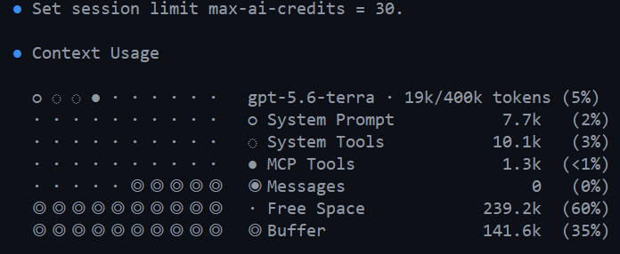
Demo recap
/limits set max-ai-credits 30 – Soft credit cap
/Context

Slide 21
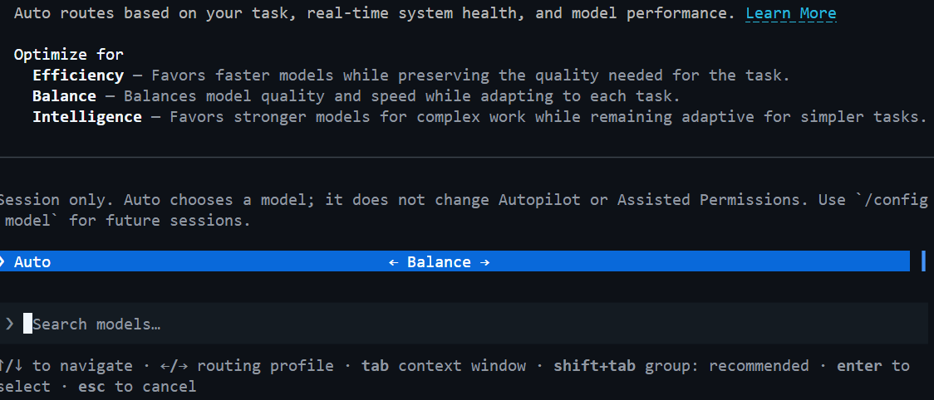
Demo recap
/model

Slide 22
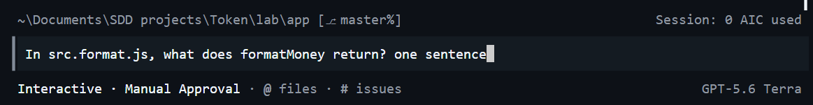
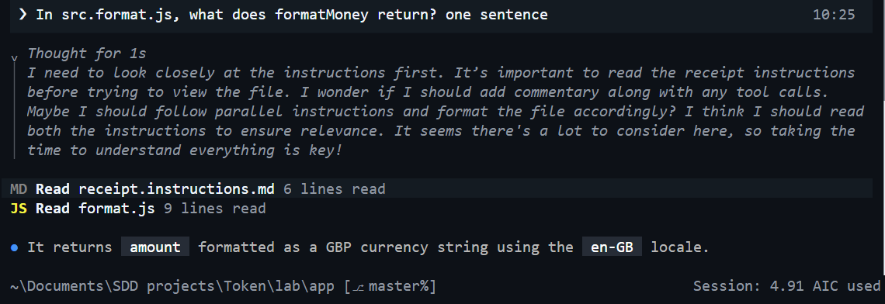
Demo recap
Prompt

Slide 23
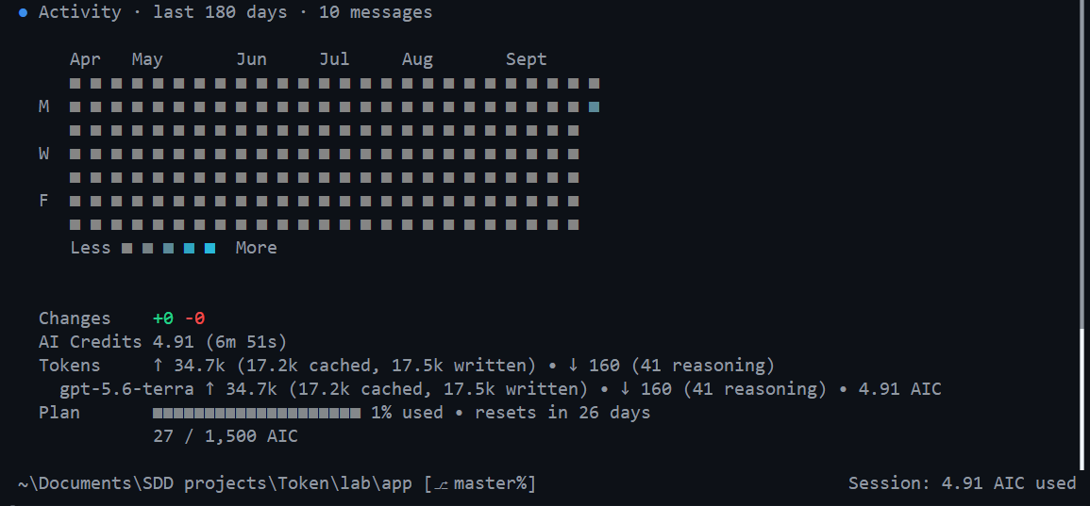
Demo recap
/usage

Slide 24
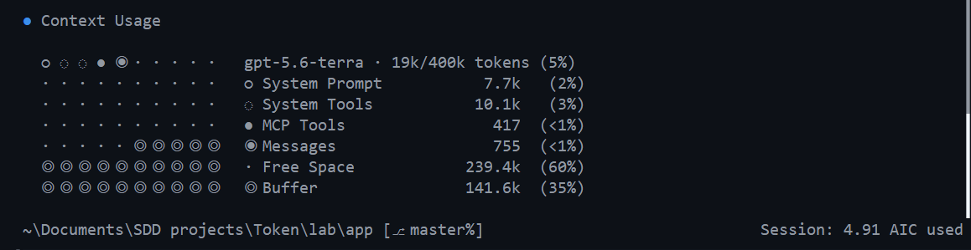
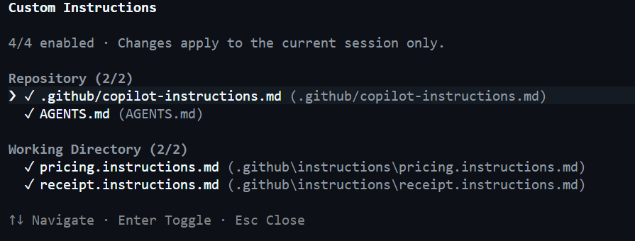
Demo recap
After Prompt
/instructions

Slide 25
Constrained outputs
Versus an essay

Slide 26
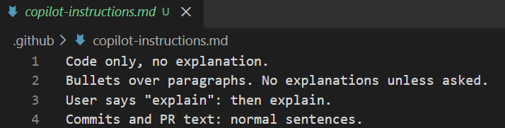
Same task. Different output cost.
Lean copilot instructions
/limits set max-ai-credits 30

Slide 27
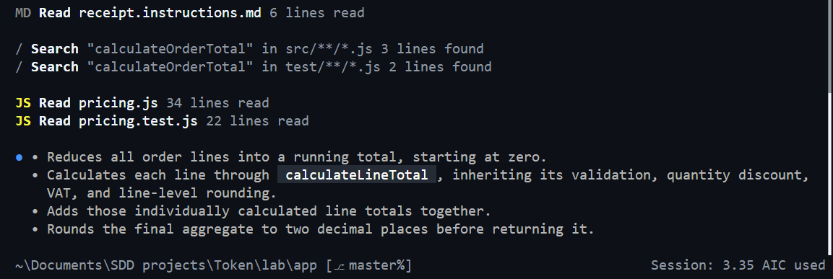
Same task. Different output cost.
How does calculateOrderTotal work? Four bullet points maximum. No example code. No alternatives.

Slide 28
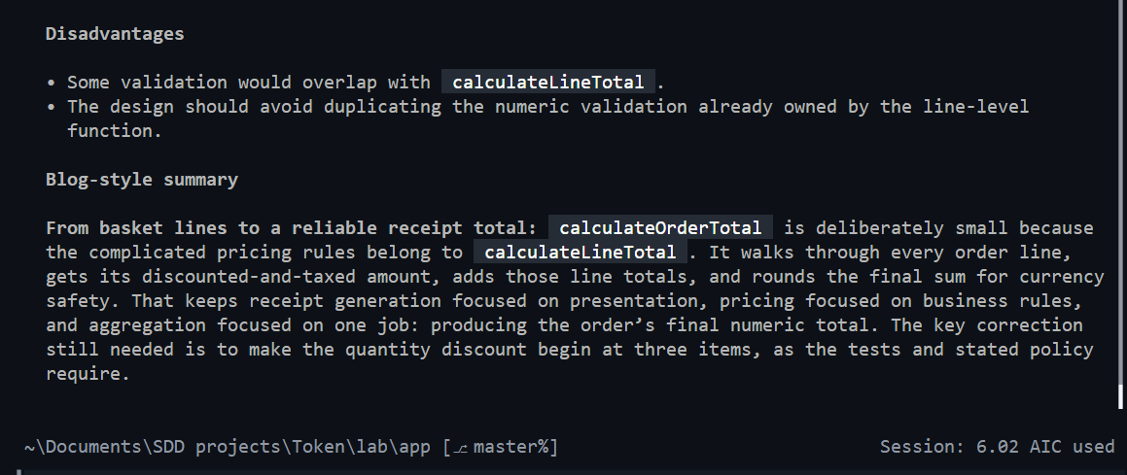
Same task. Different output cost.
/new
/limits set max-ai-credits 30
Explain in detail how calculateOrderTotal works. Include background, a worked example, alternative designs, and a short blog-style summary. Be thorough.
……… Lots and lots

Slide 29
Appendix – Demo Recaps
Demo 2

Slide 30
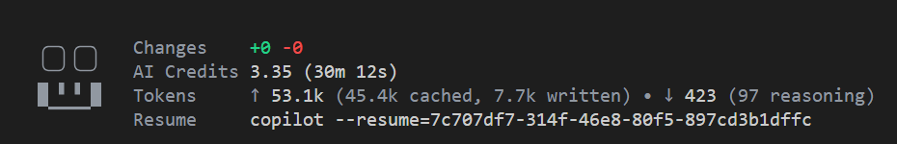
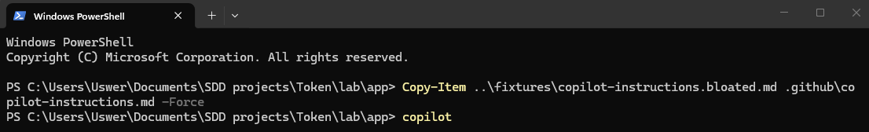
Part A — Swap the instructions without sending a prompt
exit
In powershell (lab/app)
Copy-Item ..\fixtures\copilot-instructions.bloated.md .github\copilot-instructions.md -Force
copilot

Slide 31
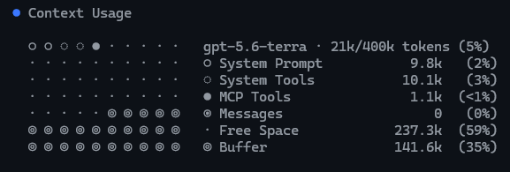
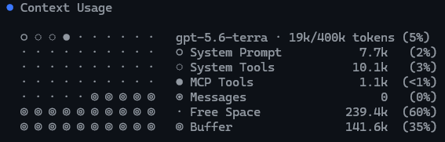
Part A — Swap the instructions without sending a prompt
/context
exit
Copy-Item ..\fixtures\copilot-instructions.lean.md .github\copilot-instructions.md -Force
copilot
Notes:
Point at System/Tools. Compare it with the number from the four-line file. On the rehearsal machine the line moved from about 7.8k to about 9.8k, a gap of about 2,000 tokens. The display rounds to one decimal place, so it will not match the 2,410-token file estimate exactly. The first-line token total should rise by the same gap. This CLI does not print a Custom Instructions row. System/Tools also includes the built-in prompt and tool definitions, so the comparison is the change, not the absolute number. Then run /instructions. That screen lists the loaded files. An empty list means they were not discovered: lab/app must be a Git repository, and Copilot must be restarted from that folder.

Slide 32
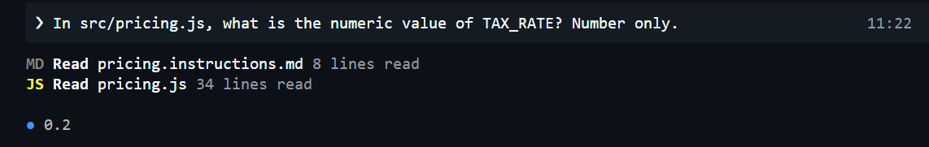
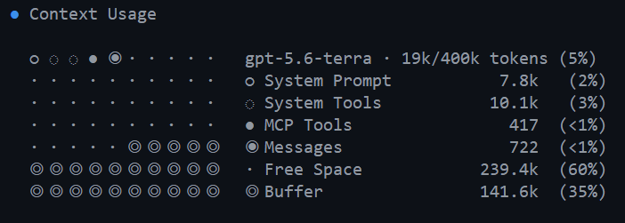
Part B — Conversation history and /new

Slide 33

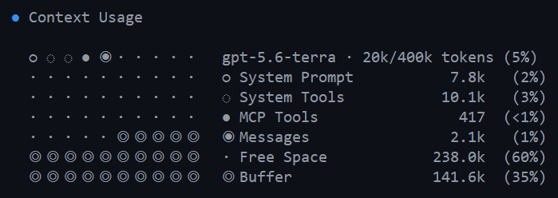
Part B — Conversation history and /new

Slide 34
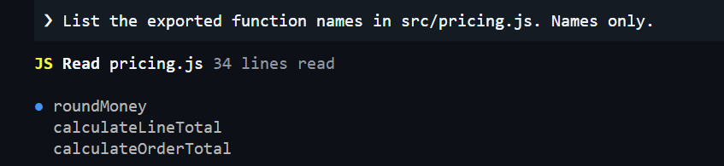
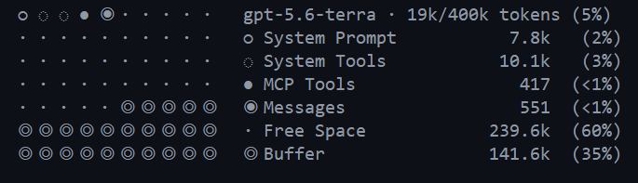
Part B — Conversation history and /new
Start a new conversation with only the second task:
/new
New problem, new chat. Same problem but a long useful thread, compact it.
Notes:
New problem, new chat. Same problem but a long useful thread, compact it.

Slide 35
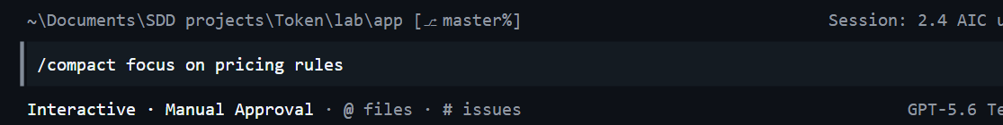
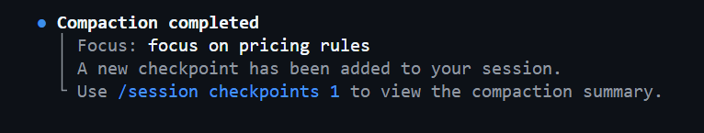
Part B — Conversation history and /new
New problem, new chat. Same problem but a long useful thread, compact it.
Notes:
New problem, new chat. Same problem but a long useful thread, compact it.
/compact is useful in Copilot CLI because it lets you keep the useful understanding from a long working session without carrying all of the conversation history around in the context window.
Every prompt, Copilot response and tool result consumes context. /compact takes that accumulated conversation and replaces it with a much smaller structured summary containing things such as the goal, work completed, important technical details, files involved and next steps.
The original conversation is replaced in the active context by that condensed representation, freeing most of those tokens while preserving continuity. GitHub specifically recommends manually compacting when you're starting a new phase of work but want to continue the same overall task
Copilot uses the compacted summary as its conversation history. You don't have to explicitly reference the compact again.
There is one important limitation: compaction is lossy. Exact command outputs, wording and minor decisions may disappear. GitHub therefore creates a checkpoint whenever compaction happens. You can inspect them later with:
/session checkpoints 2
That lets you see what was preserved in a previous compaction. GitHub Docs
For your token-optimisation course, I'd teach the workflow as:
/context → inspect token pressure → /compact <what matters> → continue working
And contrast that with /new: use /compact when you're continuing the same problem; /new when you're changing to an unrelated problem. GitHub explicitly recommends this distinction as a way of keeping AI usage efficient. GitHub Docs
One subtle point worth teaching: Copilot CLI will also automatically compact as the context gets full (normally beginning around 80%), so manual /compact is really about taking control of when it happens and what the summary focuses on.

Slide 36
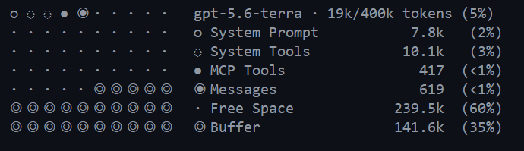
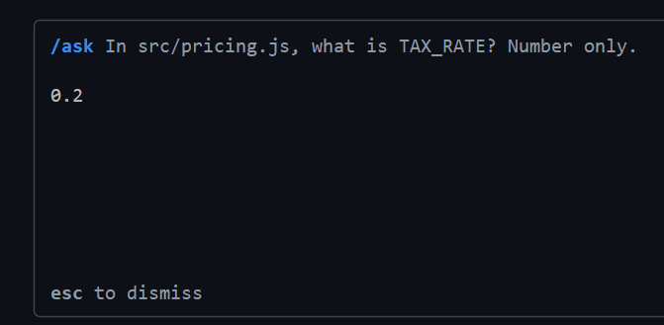
Part C — /ask versus a normal turn
/context
Record messages
/ask In src/pricing.js, what is TAX_RATE? Number only.
No new messages

Slide 37

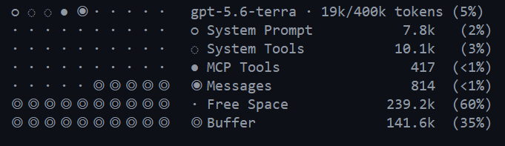
Part C — /ask versus a normal turn
In src/pricing.js, what is TAX_RATE? Number only.
The /ask exchange is ephemeral. It doesn't pollute the working context.
That's particularly useful for the token-optimisation material you're developing.
Notes:
Normal prompt = talk to the agent about the work.
/ask = ask the agent a temporary question about the work

